Slide 1



ATLIQ HARDWARES CONSUMER GOODS AD-HOC INSIGHTS
Presented By:
Ekta Goyani

Slide 2


Task
Introduction
Atliq Hardware is one of the leading computer hardware producers in India and well expanded in other countries too.
Atliq Hardware has 74 customers in 27 countries worldwide. Along with Asia Pacific(ACPC) , Europe(EU), North America(NA) and Latin America.
The management of atliq hardware informed the data analytics team to generate the some insights regarding customer behaviour to make some data driven decision.
So the task was to review 10 Ad-Hoc request.
Run SQL queries to answer ad-hoc request.
And create visually appealing and engaging presentation to communicate insghts.
And deliver this presentation to top level management.

Slide 3
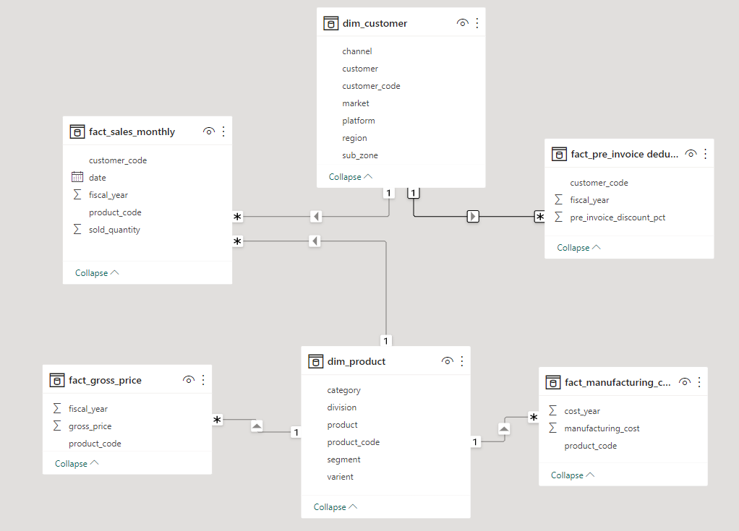
Data Schema
dim_customer: contains customer-related data
dim_product: contains product-related data
fact_gross_price: contains gross price information for each product
fact_manufacturing_cost: contains the cost incurred in the production of each product
fact_pre_invoice_deductions: contains pre-invoice deductions information for each product
fact_sales_monthly: contains monthly sales data for each product.

Slide 4
AD-HOC REQUESTS, QUERIED RESULTS, INSIGHTS AND VISULIZATION

Slide 5

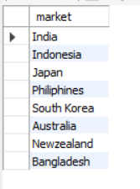
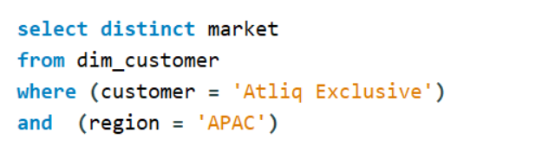
Request 1:
Provide the list of markets in which customer "Atliq Exclusive" operates its business in the APAC region.
Input Query
Output

Slide 6

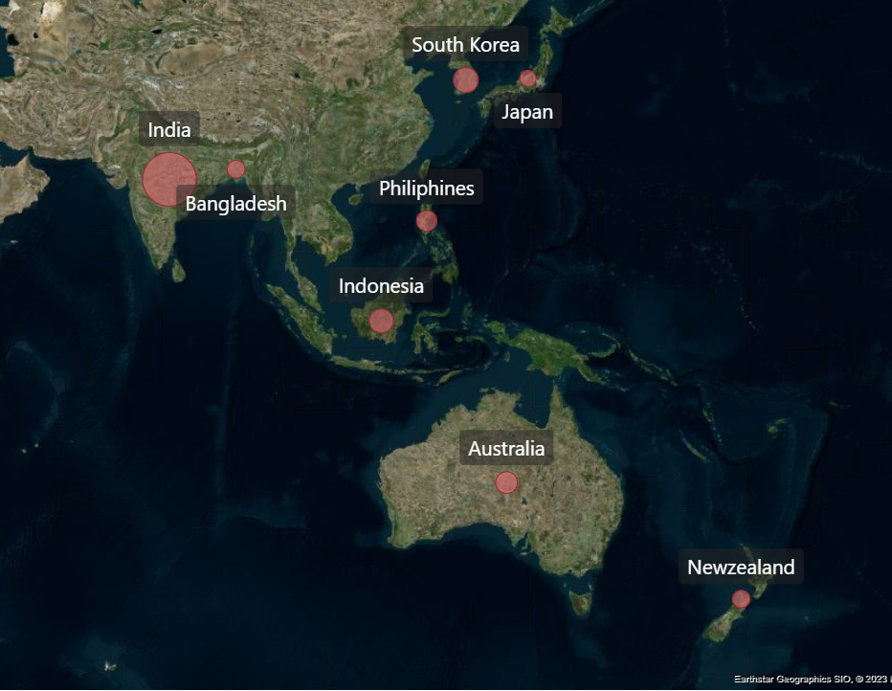
Visualization & Insights
Atliq exclusive operates it’s business in 8 countries in the Asia Pacific region, namely India, Australia, Indonesia, Philippines, Japan, South Korea, Bangladesh, New Zealand.
In the fiscal year 2020-2021 India is leading market in terms of Gross sales.

Slide 7
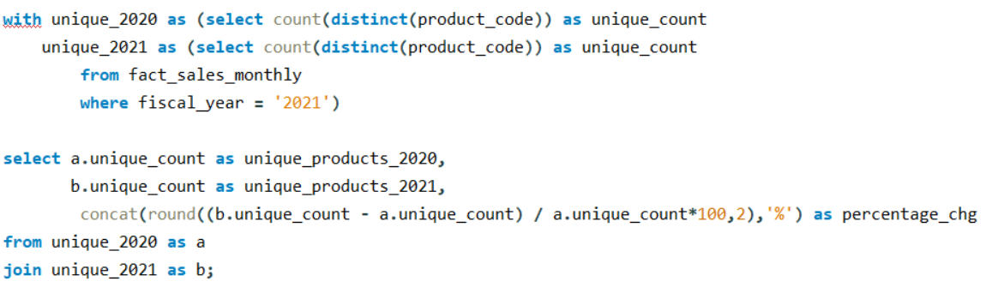

Request 2:
What is the percentage of unique product increase in 2021 vs. 2020?
SQL Query
Output

Slide 8
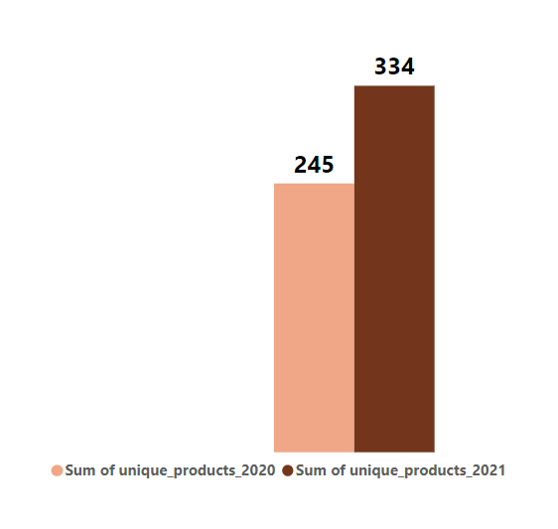
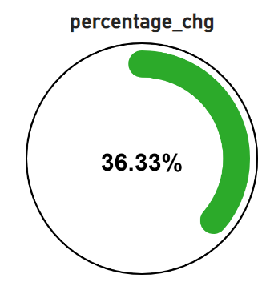
Visualization & Insights
There is significant increase in count of unique product from year 2020 to 2021 i.e. from 245 to 334. which representing increase of 36.33%.
The growth in number of unique products is a positive indicator of atliq Hardware’s performance. Atliq is producing more new products to meet customer’s demand.

Slide 9
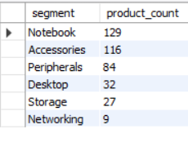
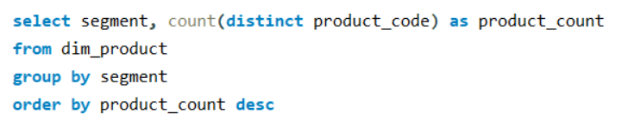
Request 3 :
Provide a report with all the unique product counts for each segment and sort them in descending order of product counts.
SQL Query
Output

Slide 10
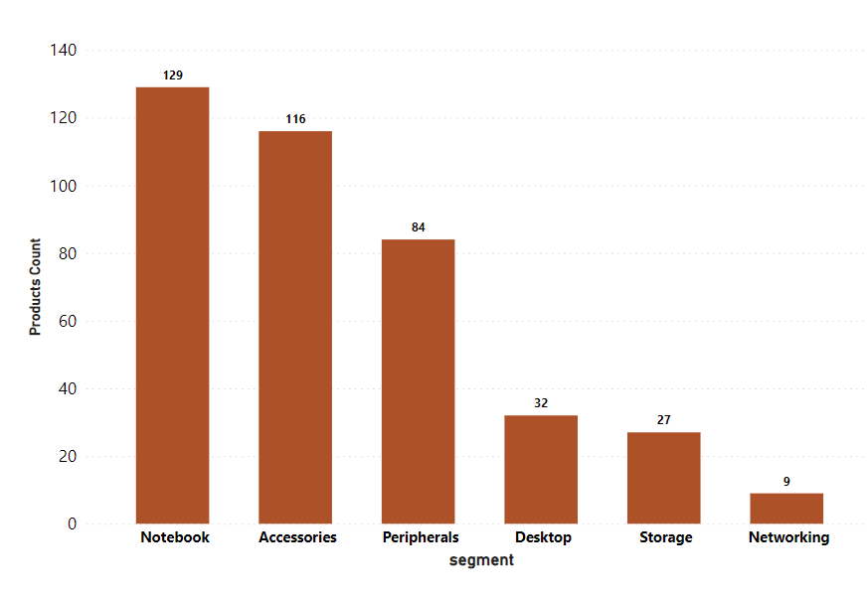
Visualization & Insights
Atliq Hardware products are diversely categorised in 6 different segment.
Among which Notebook Segment contains the 129 maximum number of unique products and Networking segment contains the minimum number of unique products counts is 9.

Slide 11
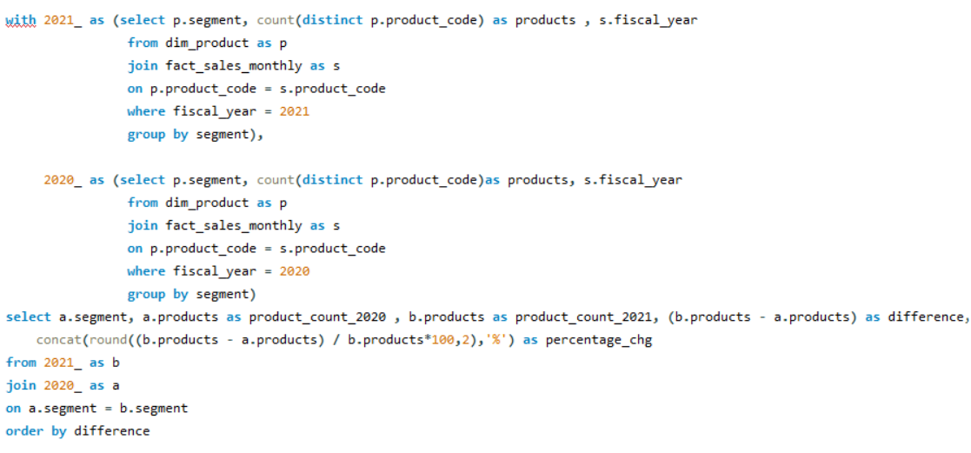

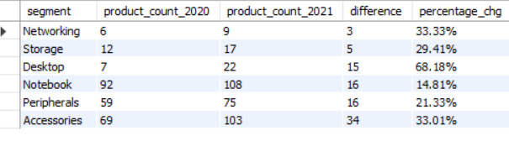
Request 4 :
SQL Query
Which segment had the most increase in unique products in 2021 vs 2020?
Output

Slide 12
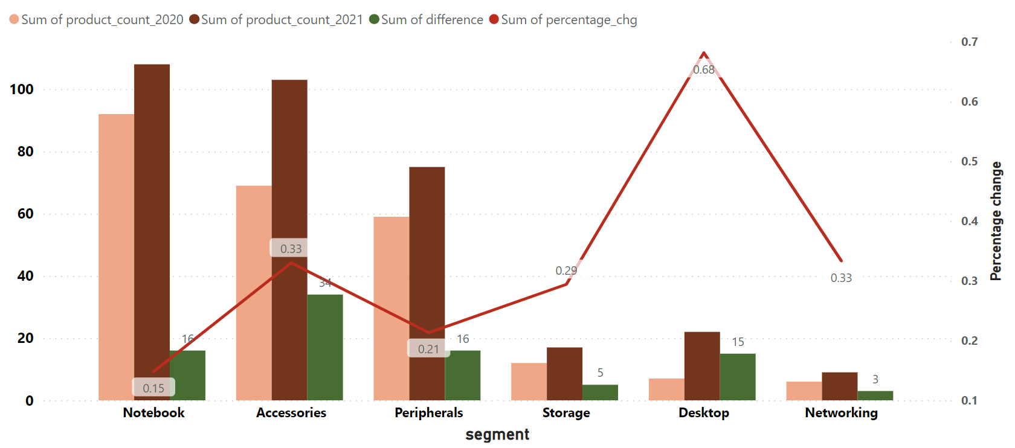
Visualization & Insights
There are total of 34 new and unique products added to the Accessories segment in 2021, which is the highest and 3 new unique product added to the networking segment in 2021 which is lowest among all 6 segment.
Desktop segment has a edge over business in the market since it has all new 15 products to its segment in 2021 which is increase in 68%.

Slide 13
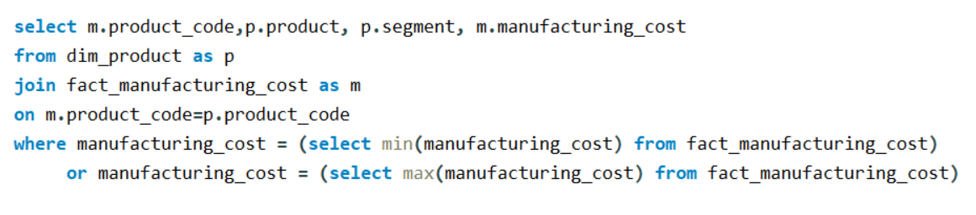

Request 5 :
Get the products that have the highest and lowest manufacturing costs.
SQL Query
Output

Slide 14


Visualization & Insights
Highest Manufacturing Cost
Lowest Manufacturing Cost
AQ Home Allin1 Gen2
Desktop
240.54$
AQ Master Wired X1 MS
Accessories
0.89$

Slide 15
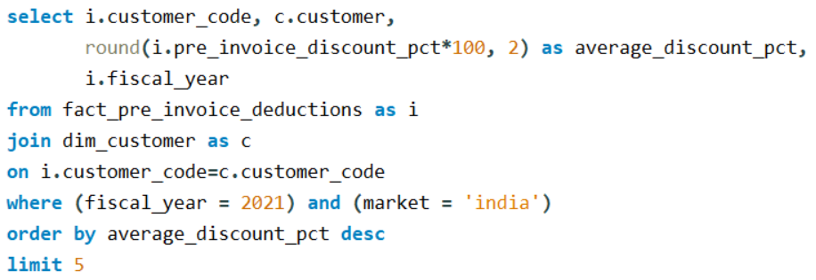
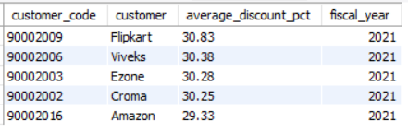
Request 6 :
Generate a report which contains the top 5 customers who received an average high pre_invoice_discount_pct for the fiscal year 2021 and in the Indian market.
SQL Query
Output

Slide 16
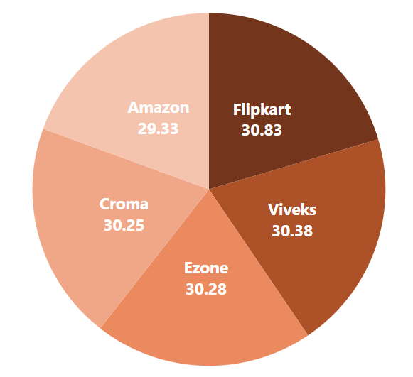
Visualization & Insights
In the Indian market the top 5 Customer were offered similar discount.
With that Flipkart have received highest discount(30.83%) and Amazon have received lowest discount(29.33%) among all top 5 Customer

Slide 17
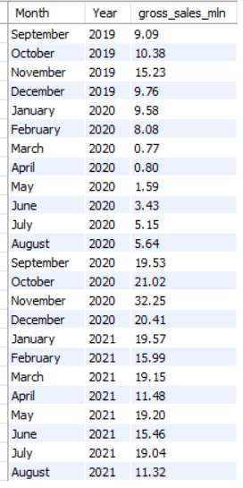
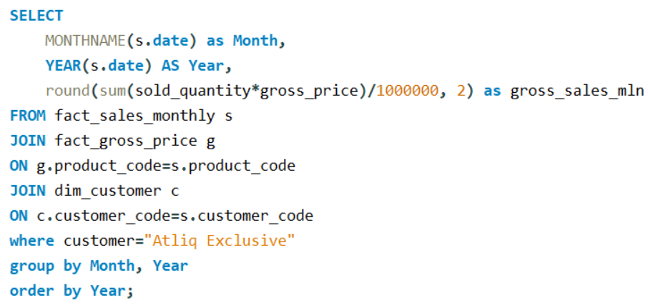
Request 7 :
Get the complete report of the Gross sales amount for the customer “Atliq Exclusive” for each month.
SQL Query
Output

Slide 18
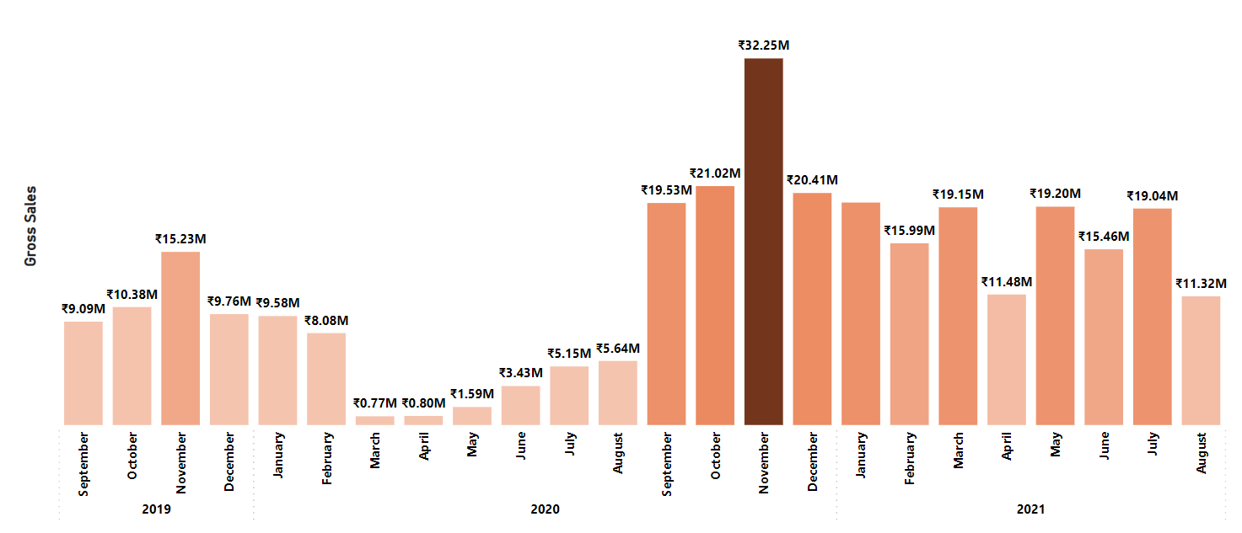
Visualization & Insights
The gross sales amount fluctuated significantly over a time.
At the beginning of fiscal year 2020 gross sales dropped which is lowest sales amount. This was most probably due to COVID-19 pandemic.
But after that gross sales increased significantly and in the same fiscal year atliq has recoded highest gross sales in November which is 32.25 million.
As per fiscal year 2019 & 2020 October, November is high performing months.

Slide 19
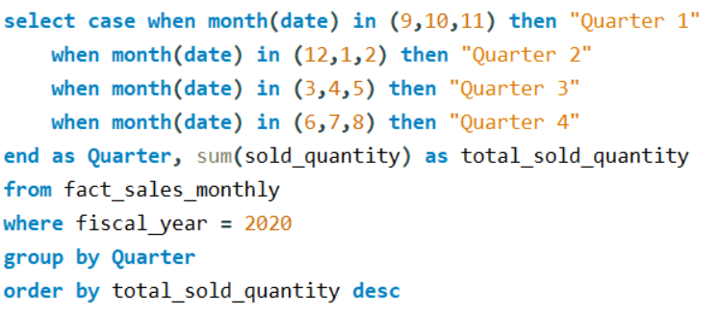
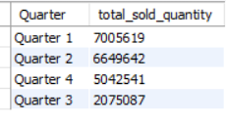
Request 8 :
In which quarter of 2020, got the maximum total_sold_quantity?
SQL Query
Output

Slide 20
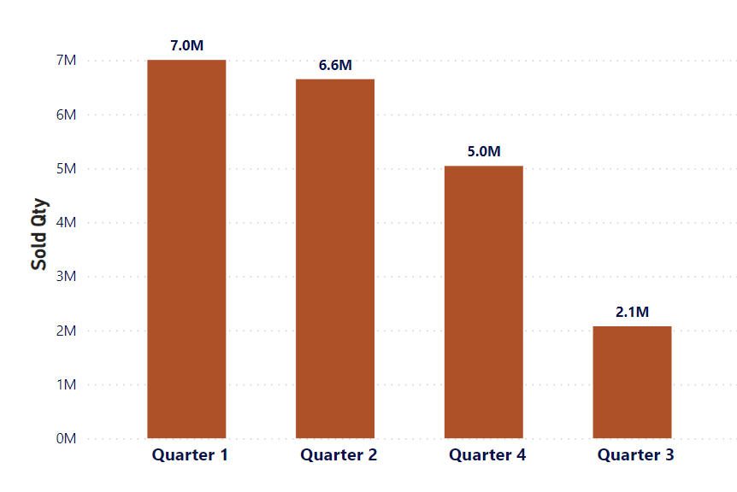
Visualization & Insights
Atliq Exclusive have experienced the highest Sold Qty is in Q1 which is 7 million and the lowest in Q3 which is 2.1 million.
Due to pandemic in March, April and May the total sold Qty dropped During third quarter of 2020.
But after that total sold quantity significantly increase this may be attribute to the increased in demand for hardware such as desktop, notebook as students shifted to online study and many job shifted to online work during this time.

Slide 21
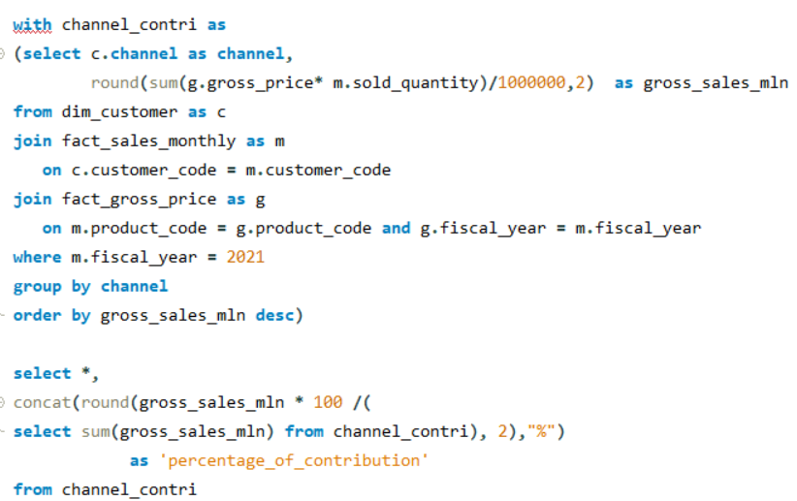
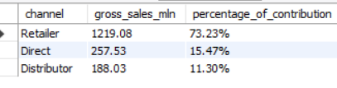
Request 9 :
Which channel helped to bring more gross sales in the fiscal year 2021 and the percentage of contribution?
SQL Query
Output

Slide 22
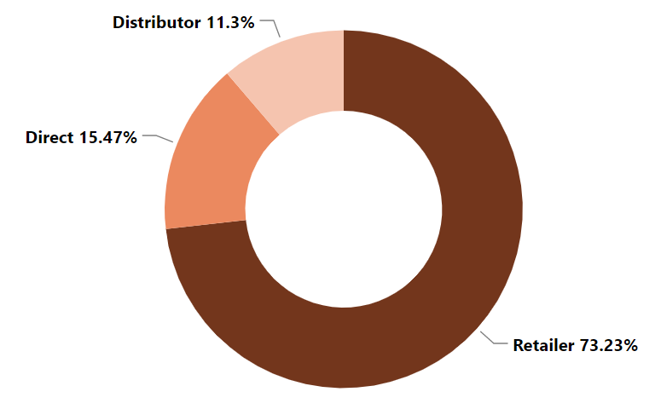
Visualization & Insights
Here we can see that company’s sales heavily depend on the Retailer, as it contribute 73.23% to total sales.
And this followed by Direct channel, which contribute 15.47% to the total sales.
The remaining 11.3% come from the Distributor channel.

Slide 23
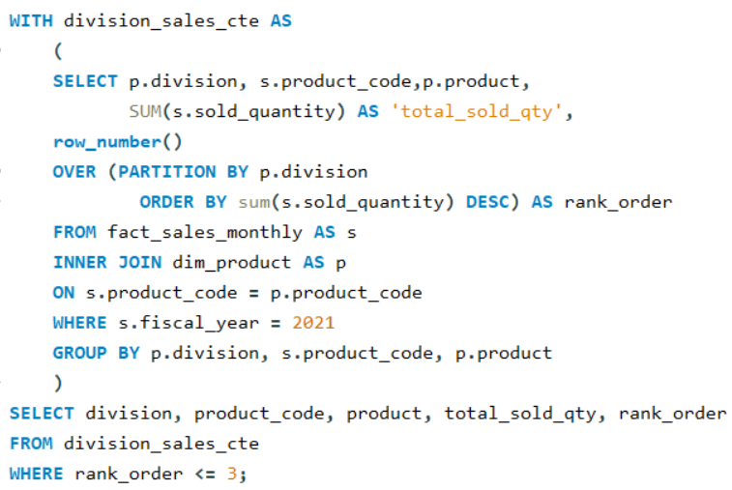
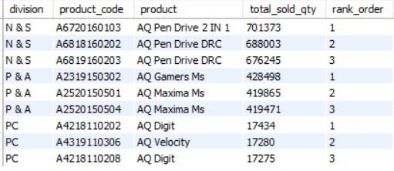
Request 10 :
Get the Top 3 products in each division that have a high total_sold_quantity in the fiscal_year 2021.
SQL Query
Output

Slide 24
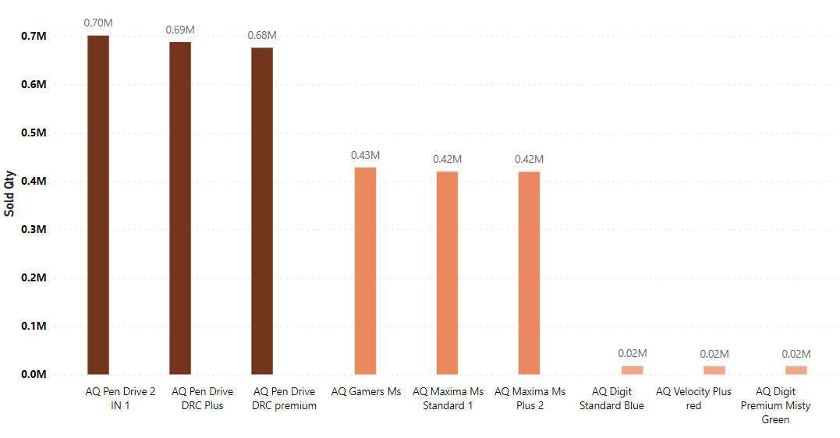
Visualization & Insights
N & S
P & A
P C
The “N&S” division has highest total sold Quantity among 3 division listed and the “PC” has three lowest selling products.
The Product “AQ Pen Drive 2 in 1” sold the highest quantity overall, followed by AQ Pen Drive DRC plus and AQ Gamers Ms.

Slide 25
Thank You

